Slide 1


User authentication using Keystroke Dynamics
Harshika T
S4 MCA A Batch
Roo.no.57

Slide 2


Contents
Relevance of the project
Description of the project
Objective of the study
Existing system and proposed system
Modules
UI design and back-end design

Slide 3
Introduction
Authentication systems like passwords, patterns, biometrics, etc. are used. But these systems have some drawbacks.
Biometric system is more secure than password and pattern. But it is more threatening to the user physically.
Hence there is a need to generate foolproof measures to prevent such unauthorized access
One such preventive method to give access to individuals by detecting their unique behavioral patterns is an individual’s typing rhythm.
This unique typing rhythm tends to become a natural choice for the security of computers and is commonly known as Keystroke Dynamics

Slide 4
Relevance of project
Better security is provided.
Identify the user by their manner and rhythm of typing.
Emerging ways to strengthen user authentication.

Slide 5
Description of project
The project is like a webpage, which gives the user access to log into the home page by only using the keystroke dynamics.
Keystroke dynamics is the study of whether people can be distinguished by their typing rhythm.
The unique typing patterns of users can be used as a signature to identify genuine users from imposters.
The user will be provided with a phrase and they should type accordingly, it checks whether it is a genuine user if yes then it will give access else deny.
It collects the data like the latency, speed, time, etc used to type the phrase and stored it. And used at the time of login to check.

Slide 6
Objectives
To ensure security to the users for the passwords by behavioral biometric.
To distinguish people by their typing rhythm
To ensure correct identification and verification of respective user.

Slide 7
Existing system
Authentication is an important factor in computer and network security.
There are many techniques currently used in the authentication. The most common is the password and biometrics.
In the case of passwords it doesn’t require other hardware, but there is a chance for forgetting the password or sharing it with others.
Considering the case of biometrics it required another specialized hardware.

Slide 8
Proposed system
The proposed model records the unique typing style and pattern of a user at the time when they register into the system by feature extraction and trains the knowledge base with these feature data.
They try to log into the system or access the system in any way. The model provides advanced-level security to critical systems
The model does not require any extra hardware

Slide 9
Algorithm
The algorithm used in this model is Decision tree.
Decision tree are suited for classiﬁcation problems having a small number of output categories.
Decision trees provide a clear indication of which fields are most important for prediction or classification.

Slide 10
Input/Output
Input of the project is the keystroke values collected at the time of registration
Output is whether the collected data and login data are same,if the same it gives access to the user. else it will deny access.

Slide 11
UI design and implementation
UI is designed by using html,css,javascript and it is connected by using Flask.
Modules:
Registration phase
Verification phase

Slide 12
Methodology
This model is used to secure the password of the user. A user can only access his or her account because of the unique typing way of each. In this system the model collect the method of typing and speed by providing phrase to the user by typing it . The way of typing time and speed are understand from it and stored. Then in login time other than username and password we should also type the phrase. If this matches then the model will give the access. Through this model we can avoid the un authenticated access .It provide more security.

Slide 13
It consist of many phases like registration, verification, analysing etc. Here the dataset is extracted at the registration time. The input is given by the user and it is collected and stored in the database.
Various standard machine learning algorithms are used to keystroke identification. Among the selected algorithms, the Decision Tree provided the best accuracy. Decision tree is the most powerful and popular tool for classification and prediction.

Slide 14

Screenshots

Slide 15
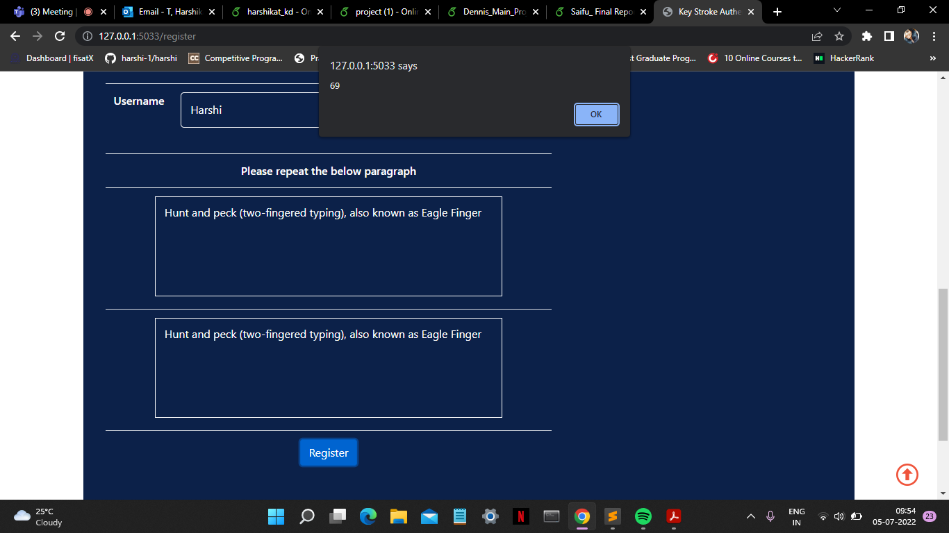

Slide 16
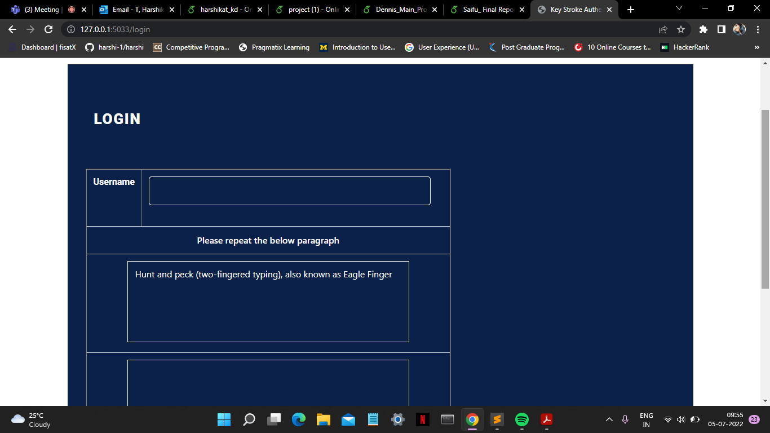

Slide 17
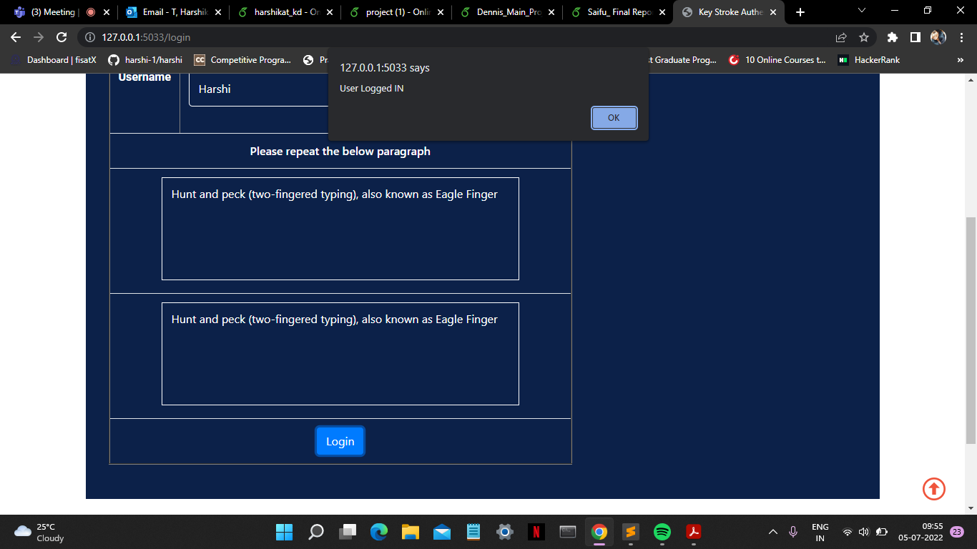

Slide 18
